Slide 1

Presentation for Summer Internship Project on B-Tree Indexing
By-Guneet Malhotra
IT-Evening
Enroll No: 01496303119
Submitted to: Ms. Minakshi Tomer

Slide 2
Contents:
Company Profile
Tools and Technologies
Project Implementation
References

Slide 3
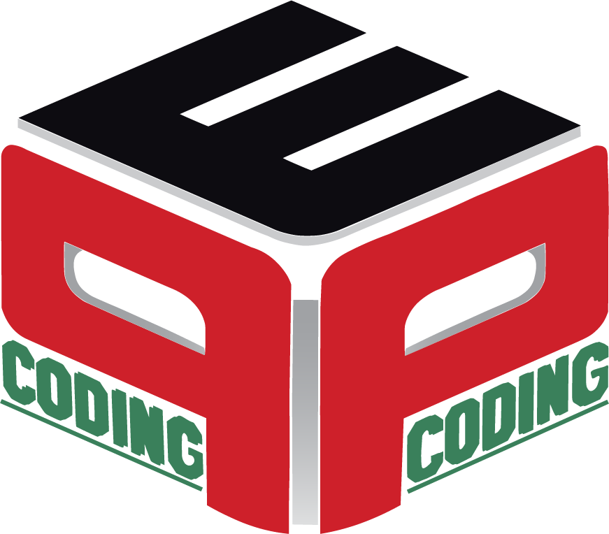
Company Profile
Pepcoding Education (OPC) Private Ltd.
Pepcoding was formed by Mr. Sumeet Malik in December 2017.
The aim of the company is to achieve the Pursuit of Excellence and Peace (PEP) through Coding and thus named Pepcoding.
Pepcoding is an Ed-Tech company and provides free and paid educational services.
Pepcoding has a YouTube family of more than 80 thousand and still counting and a LinkedIn family of 20,000 (still counting).
The company has experienced more than 121% headcount growth.
Currently, the company is working with more than 260 employees and the hiring drives are conduct almost on a regular basis. Pepcoding believes in Skills Over a Degree and hence launched the NADOS APP and the NADOS WEBSITE where NADOS stands for (Not a degree, only skills) emphasizing the importance of having employable skills over just a degree.

Slide 4
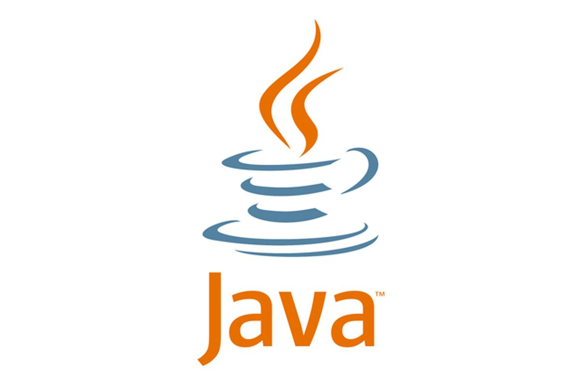
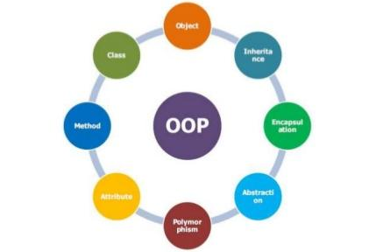
Tools and Technology
Java
Java is a high-level language which was developed by James Gosling in 1995 at Sun Microsystems.
Since Sun Microsystems was acquired by Oracle on January 27 in the year 2010, Java is currently owned by Oracle.
It is an Object-Oriented Programming language and after the inclusion of Wrapper Classes, Java can be considered as a purely Object-Oriented Language.
An Object-Oriented Programming Language is one which follows the principles of Object Orientation.

Slide 5
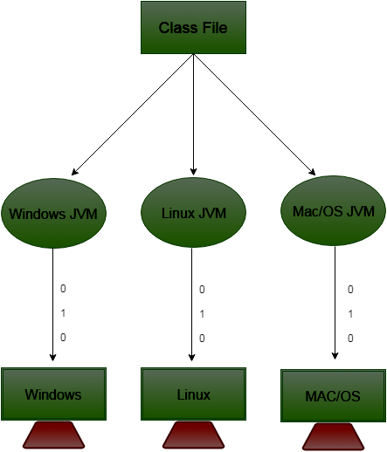
Java is Platform Independent:
One another very important feature of Java is its platform independence.
Java is not like C/C++ which generate the machine code for the source code.
Java Virtual Machine generates a bytecode for the source code i.e. a .class file is generated for the source code and that bytecode can be sent to any operating system that has JVM.
JVM is different for different operating systems as shown in the diagram .
Hence bytecode in MacOS knows how to execute the bytecode in MacOS and the one in Windows and Linux knows how to interact with their respective OS.
So, the same bytecode can be executed in any Operating System.
This is the platform independence in Java.

Slide 6
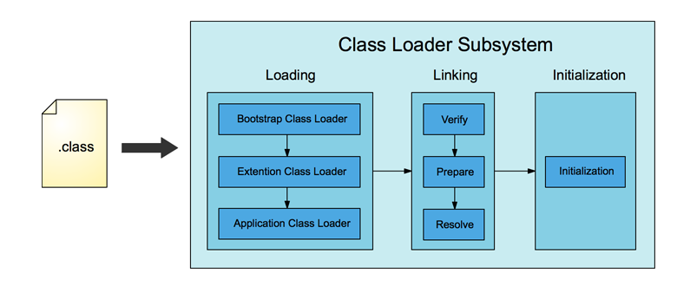
Java is Secure
One of the other most important features of Java is that it is secure.
When the bytecode is taken by the JVM to interpret using the interpreter or JIT compiler, the app classes and the Java runtime and SE classes are loaded in the Class Loader inside JVM.
After the loading, the linking process starts and the first step is the verification where the JVM verifier verifies whether the bytecode is safe and secure or not.
If there is any malware, the bytecode is not executed and we get verification warning/exception meaning our bytecode is corrupted.

Slide 7
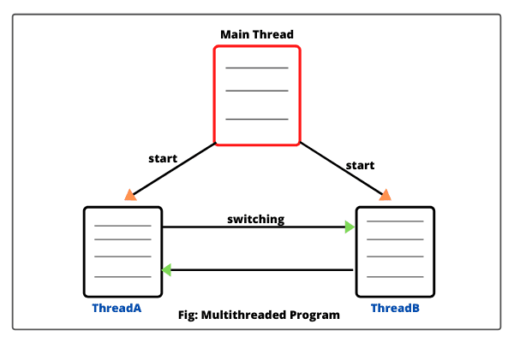
Java Supports Multithreading
Java Supports Multithreading i.e. multiple threads of a process can run at the same time by CPU.
In reality, CPU cannot run more than one thread at a time. So, the CPU switches/alternates between the multiple threads and gives its fraction of time to each thread.
If we want a thread to be executed first or we want CPU to give more time to a thread, we can change the priorities of the threads accordingly.
Multithreading is a strong programming tool provided by Java. Although, most operating systems have multithreading but, Java has its own multithreading features that can run even if the OS does not support multithreading by itself.

Slide 8
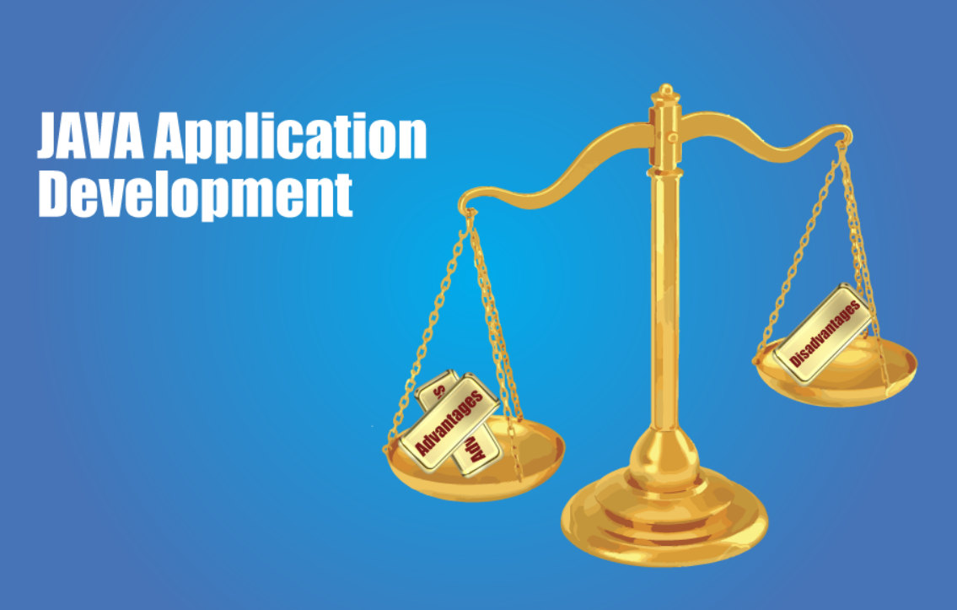
Disadvantages of Java
Every technology has its own advantages and disadvantages.
However, the scale of advantages in Java is heavier than the scale of disadvantages, still there are some disadvantages that are considerable.
Java is both compiled as well as interpreted. This makes the overall execution process of a java program slower as compared to the other languages like C and C++.
Java takes more memory as compared to C/C++ programming languages. The garbage collector provided by Java is highly responsible for this.
The GUI of the Java based applications whether made using the Swing framework or the normal Java AWT is not very attractive.
The programs written in Java are verbose. This means that lot of words and lengthy sentences are used in writing Java programs.

Slide 9
Project Introduction and Need
An SQL database is a database in which the data is stored in the form of rows and columns.
However, the same data is stored inside the disk in the form of files and folders.
These folders are called as extents and the files are called as data pages.
Each data page will store the rows which were present inside the SQL data base.
The size of each extent is usually max 64 Kilo Bytes i.e. 64 KB .
The size of each extent is usually max 8 KB.
Thus, an extent can have a maximum of 8 data pages.
If a search query is made such as SELECT * FROM TABLE WHERE Name = “John”, the sequential search is bound to take place i.e. each row inside each data page inside each extent is searched for the data. This is called TABLE SCAN SEARCH METHOD.
If we create indices upon the data and use the B-Tree data structure for searching, the search time will be reduced exponentially. This search method is called INDEX SEEK SEARCH METHOD.
In this project, the search speed and efficiency of INDEX SEEK METHOD and TABLE SCAN METHOD is compared and illustrated.

Slide 10
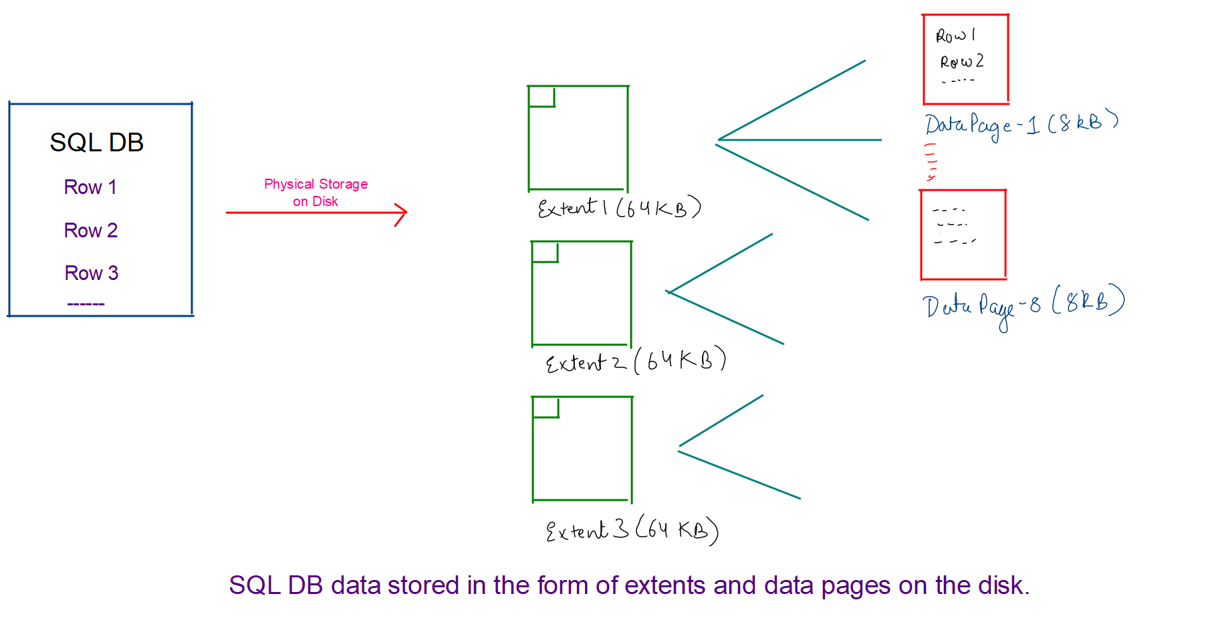

Slide 11
Say there are 8 x 10⁹ rows in the DB each being of size 1 KB.
Each row is of one KB so Data pages will 8 rows each because max size of data pages = 8KB.
If we create indices upon roll no (int size = 4 Bytes), we can store 2000 roll numbers in a page (8KB/4Bytes)
We divide 8 x 10⁹ by 2000, we get 4 x 10⁶.
So, the root index page will have the address of 2000 rows with a gap of 4 x 10⁶
The further pages will again have 200 rows and the gap keeps on reducing.
At the leaf of the B-Tree, we will have all the data.
This is how index pages are constructed.
1
4 x 10⁶ + 1.
8 x 10⁶ + 1.
12 x 10⁶ + 1…….
Root page
1
2001.
4001.
8001…….
4 x 10⁶ + 1.
4 x 10⁶ + 2001.
4 x 10⁶ + 4001
4 x 10⁶ + 8001
B-Tree Indexing

Slide 12
Project Database
Roll No Name Username Password
1
Random
Name
Random
Username
Random
Password
2
Random
Name
Random
Username
Random
Password
3
Random
Name
Random
Username
Random
Password
4
Random
Name
Random
Username
Random
Password

Slide 13
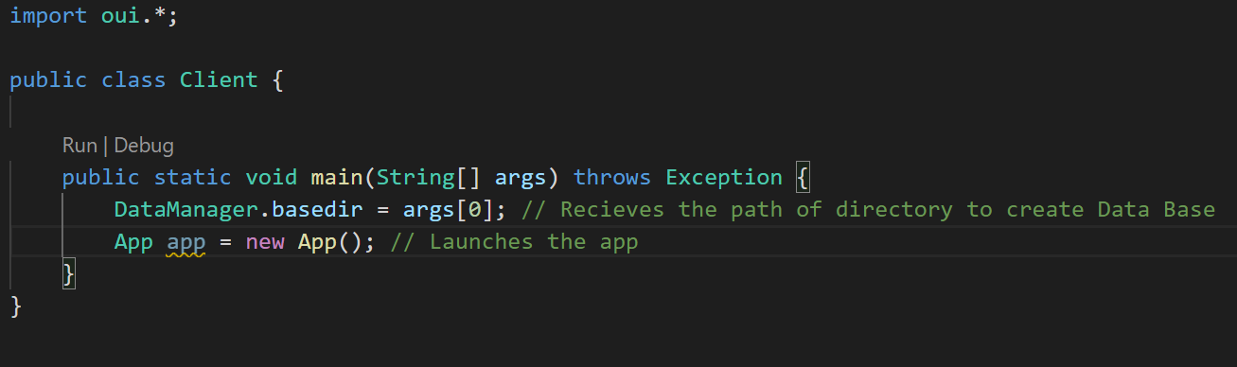
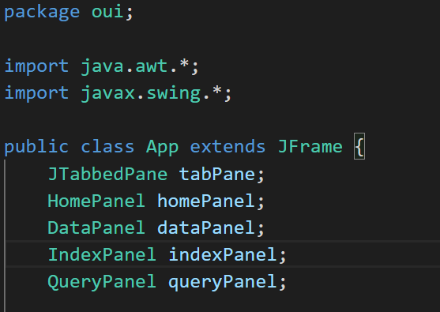
Home Panel
The Home Panel is the welcome page of the project.
Java Swing framework is used to build the GUI of the project and hence the GUI of this page too.
This page has a Tabbed Pane and the Home Panel is the active page.
It has a Text Field telling about the introduction of the Project and its aim.
The Client.java file is the file responsible for running of the project.
It creates an App() constructor which has the Tabbed Pane and all the four panels inside it.
App() constructor when fired, creates the JTabbedPane and adds itself to the super class i.e. the JFrame class.
The visibility is also set to true so that the Tabbed Pane is visible on the window.
Client fires the app
App constructor

Slide 14
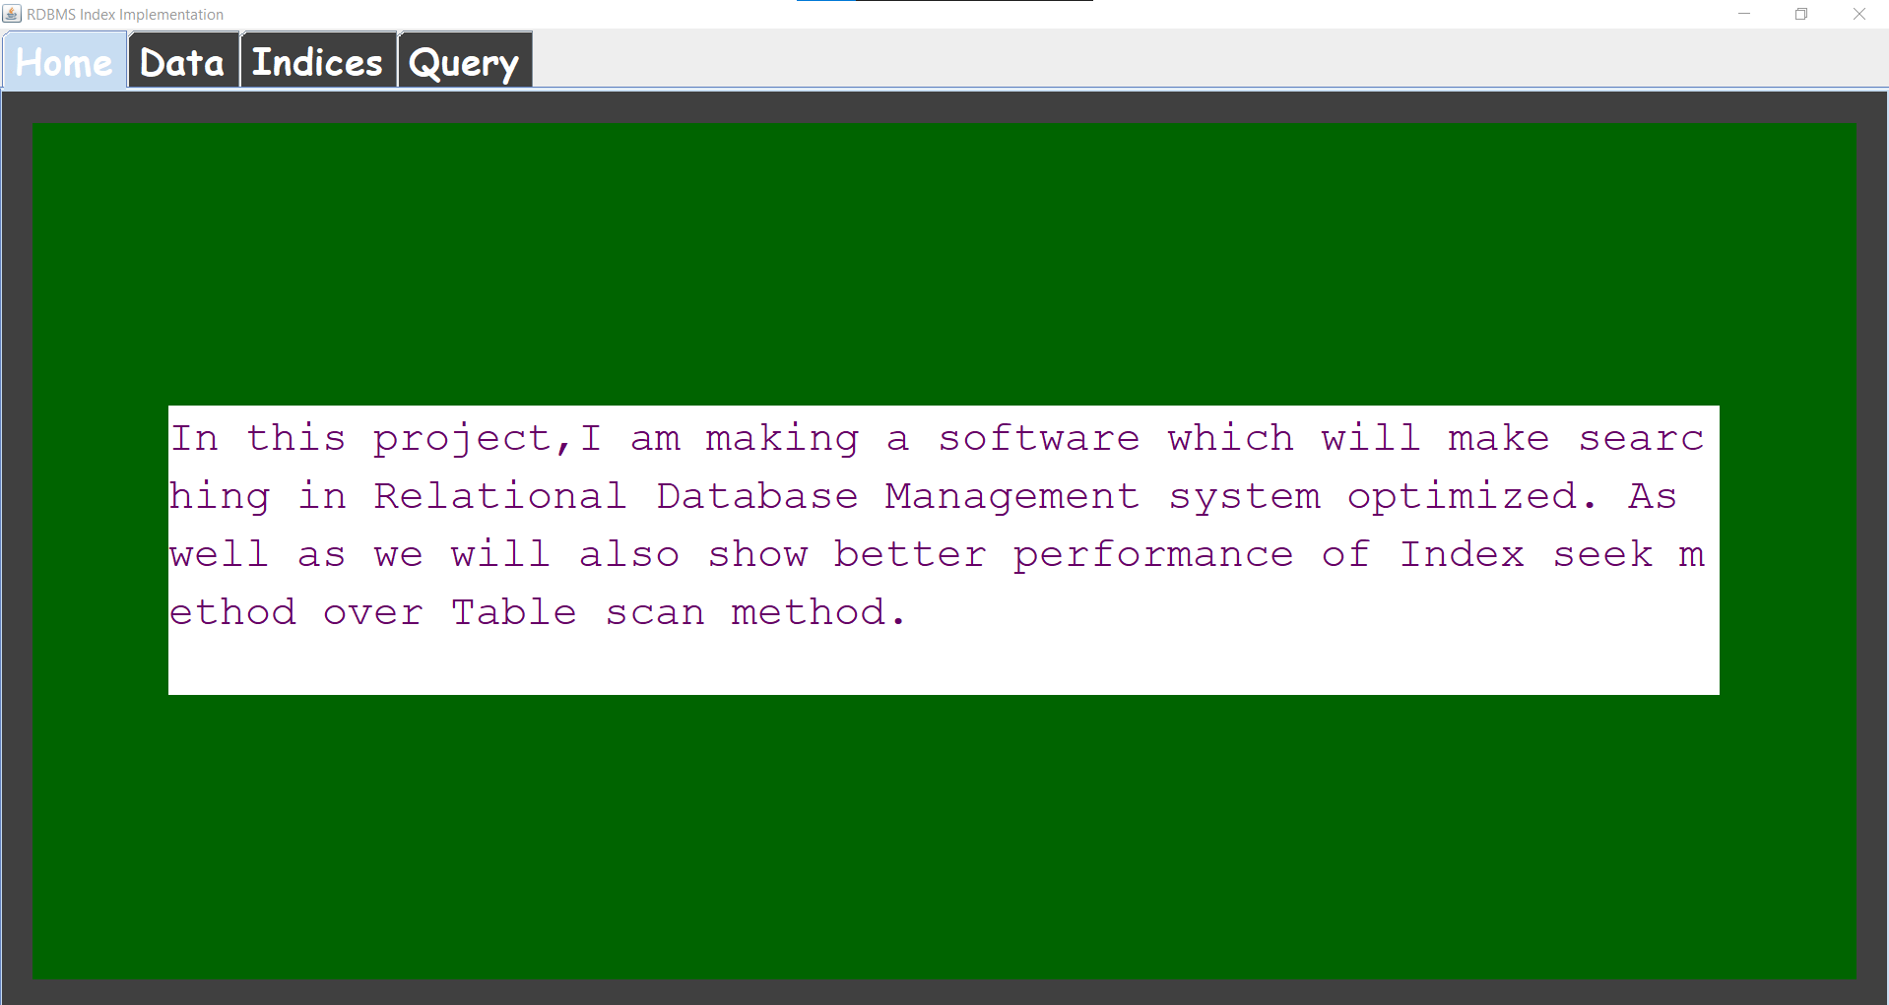
The home panel that appears when the Client.java file is executed. We can see the JTabbedPane where we have all 4 panels. The text field is present at the centre of the screen and it shows the main aim of the project. The background colour and positioning have been setup using Swing framework by creating a private class method called initComponents().

Slide 15
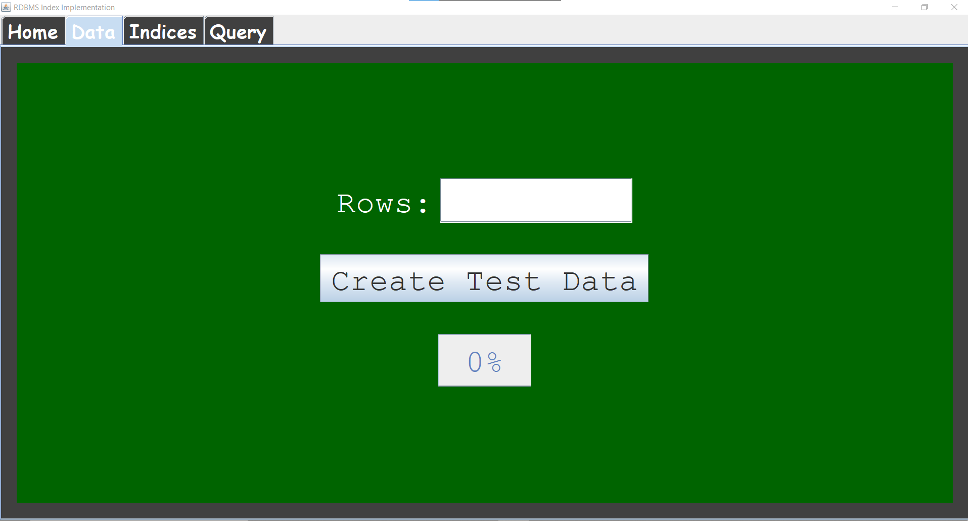
Data Panel
The Data Panel is the next Panel. Here, we have a label, text field, button and a progress bar as shown on the left. The label has “Rows” written in it and the text field/text box will be used to enter the number of rows that we want to have in the Database. The “Create Test Data” button creates the random test data of the input number of rows. The progress bar shows the progress of creation of the random test data.

Slide 16
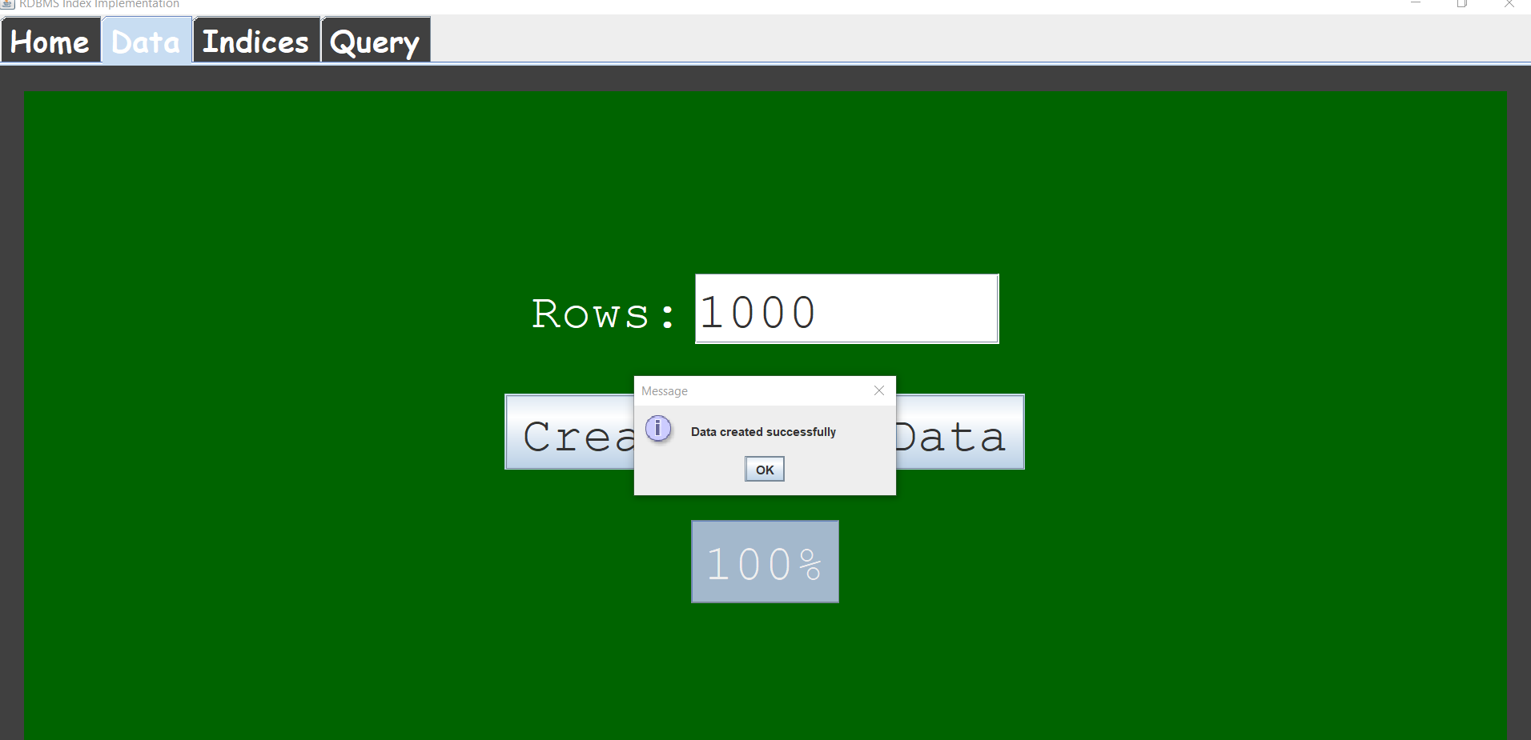
As shown in the image, we entered the number of rows = 1000 and after the creation of the test data, we got the dialog box or the message box giving the message, “Data Created Successfully”,
The progress bar also reaches 100% on complete creation of data.

Slide 17
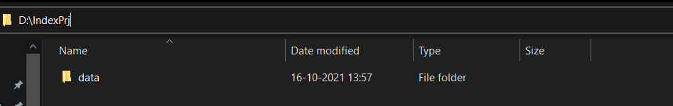
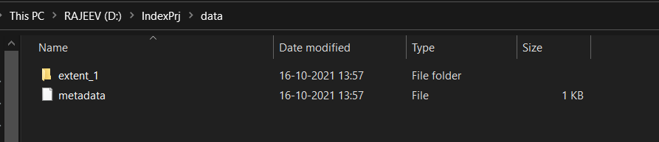
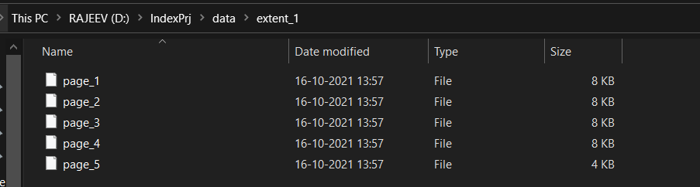
The images below show the created test data.
The data folder is created.
Inside the data folder, we have extents and meta data file.
Inside the extents, we have data pages.

Slide 18
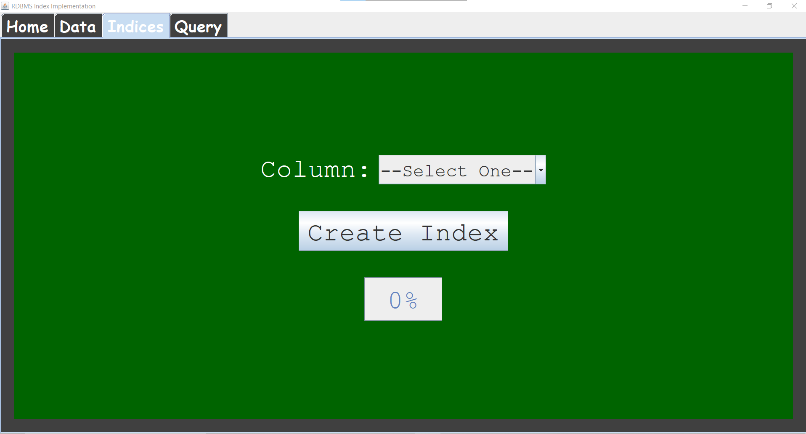
Index Panel
The Index Panel is the next panel. Here, we have a text field, a dropdown menu called a combo box in Java Swing, a “Create Index” button and a progress bar that shows the progress of the Index Creation process. The drop-down menu lets us select from the columns “Name”, “Username” and “Password” on which we want to create the indices. The “Create Index” button creates the index pages for the selected column and the progress bar shows the progress of creation of index.

Slide 19
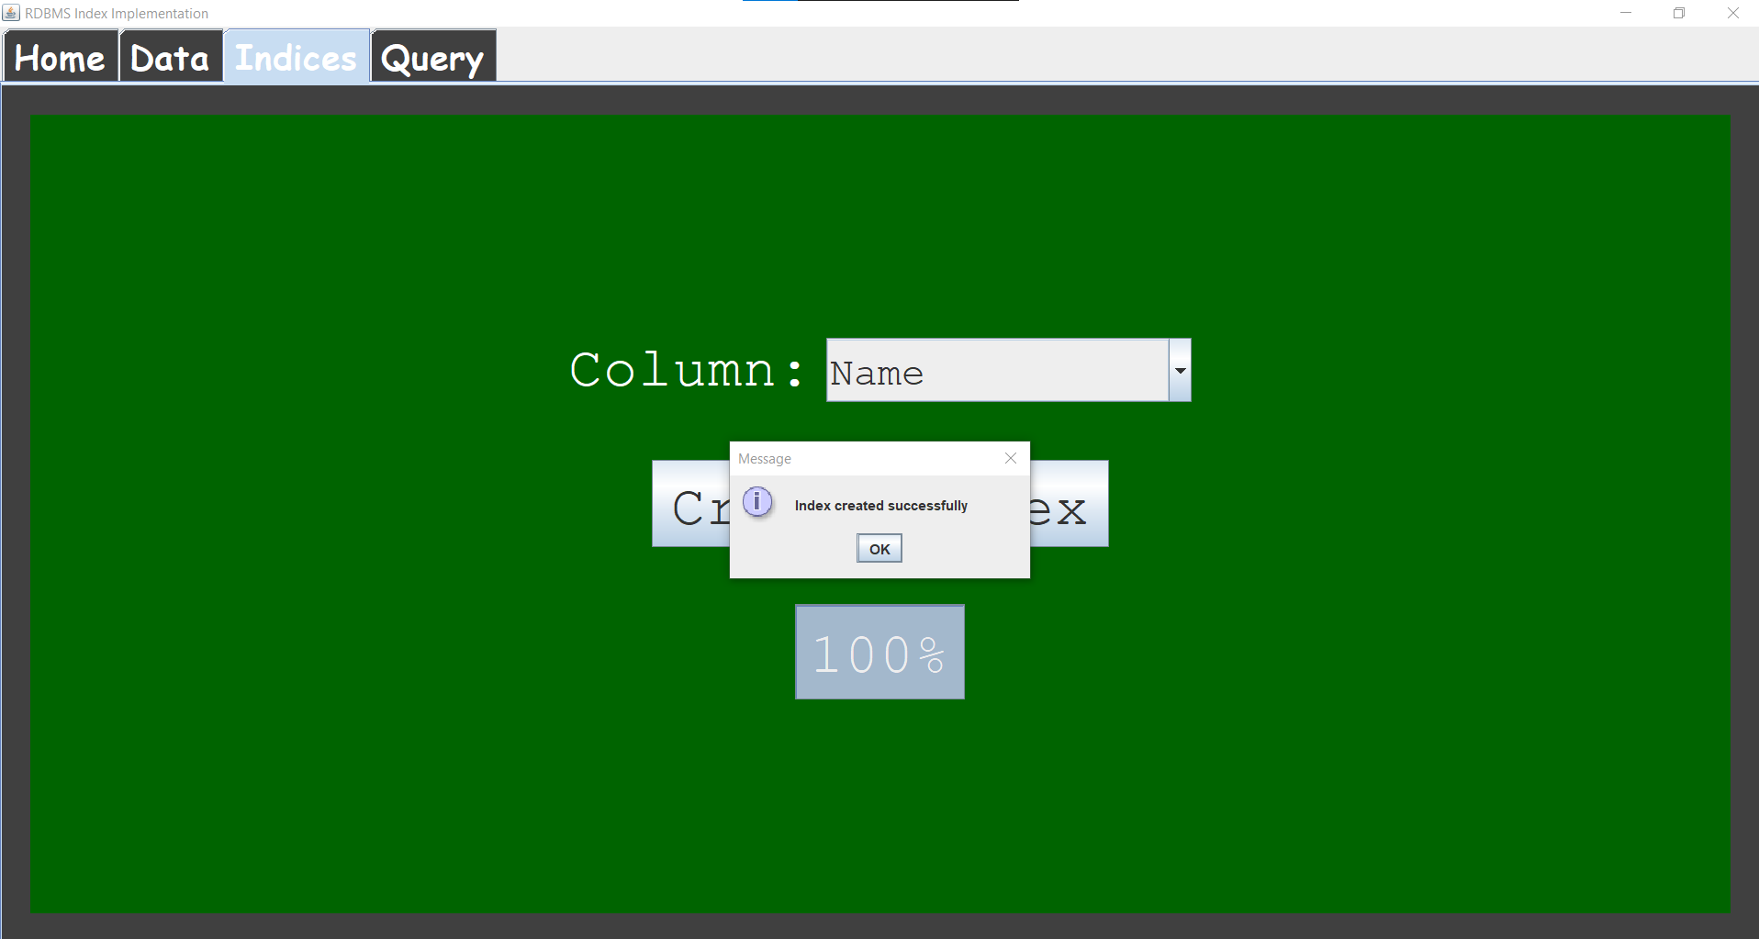
As shown below, we have selected the “Name” column to create the indices upon and we see that it takes some time to create the indices as for creation of indices we need to read the entire data for once.
After the indices are created, a message box with the message “Index Created Successfully” is shown and the progress bar reaches 100%. The indices are also created along with the data folder.

Slide 20
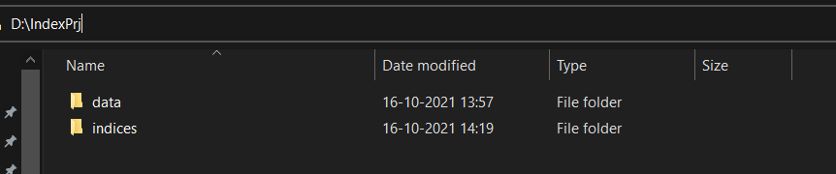
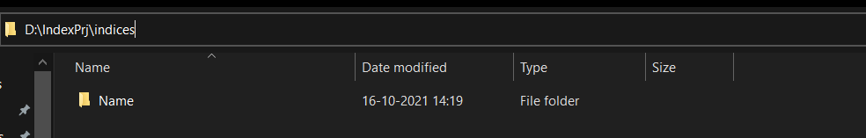
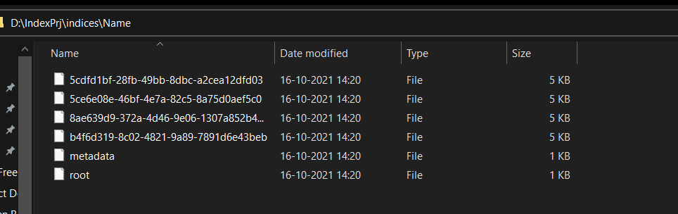
The indices created are shown below:
The indices folder is created along with the data folder
The Name folder is inside the indices folder
Inside the Name folder, we have the index pages. The first index page is the root page and we also have a meta data file for the indices.

Slide 21
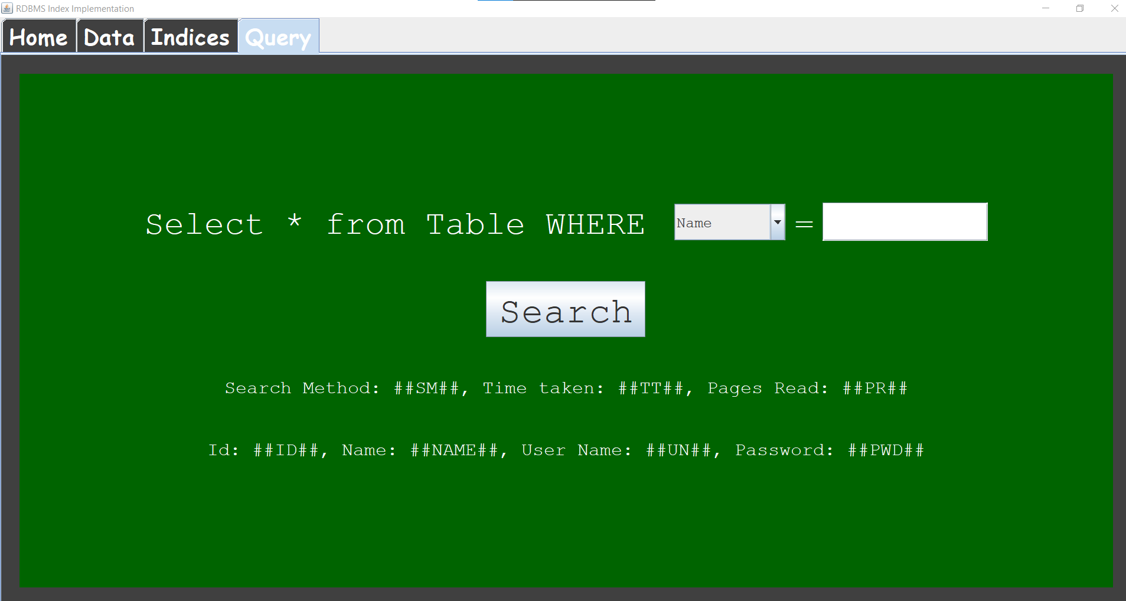
Query Panel
The Query Panel is the last panel of the Project. Here, we have a text field written with the query statement, combo box to select from the columns, another text field with equals sign, text box to enter that column value, a “Search” button and 2 text areas at the bottom for displaying the results of the search.

Slide 22

As shown in the image below, we have selected the “Name” column from the combo box and we have entered the name value that we want to search for.
If we have created the indices upon the name column, the Index Seek Method will be implemented as shown below and the search results will appear.

Slide 23

The image shows that the search for the same row offset was made but using the column for which indices were not created. Hence, Table Scan method is used which reads 3 pages and takes 77ms time compared to 2 pages read in 16ms time using Index Seek Method in the previous slide.

Slide 24
References
1. Database System Concepts taught in class and text reference textbook by Abraham Silberschatz, Henry F. Korth, and S. Sudarshan
2.Bulk loading in https://en.wikipedia.org/wiki/B
3.B Tree in https://en.wikipedia.org/wiki/B%2B_tree
4.Dynamic Programming: https://en.wikipedia.org/wiki/Dynamic_programming
5. Donald Kossmann and Konrad Stocker, “Iterative Dynamic Programming: A New Class of Query Optimization Algorithms”.
6. Data Structures and Algorithms in Java, Michael T.Goodrich, RobertoTamassia, Michael H. Goldwasser

Slide 25
Thank You
With this, I conclude my presentation

